Slide 1
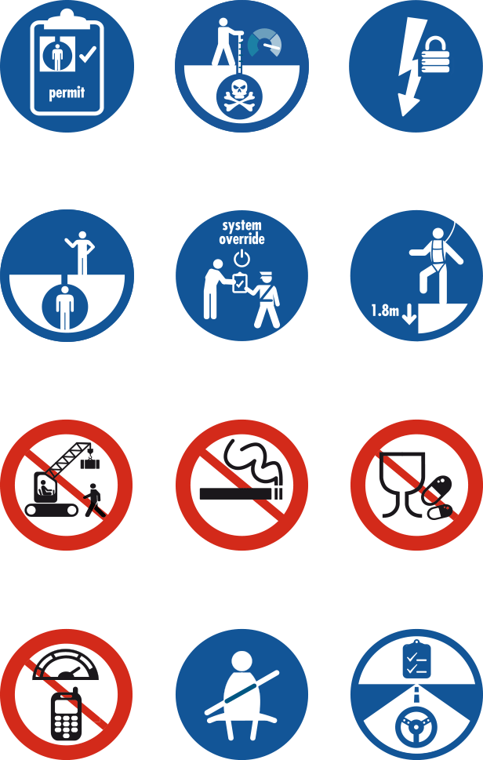
RE-ENERGISING
THE LIFE-SAVING RULES
ENGAGEMENT MATERIALS
Notes:
Information for supervisors:
Please go to the next page (slide 2) to find guidance on how to prepare for this session successfully
The session is intended to be held face to face where possible

Slide 2
Instructions for supervisors
This session should be run by the direct Supervisor or manager of a work group (not the HSE representative)
Download the video, reflection guide and this presentation well in advance of the engagement session and please follow the download instruction carefully.
Organise a suitable room for the engagement session, preferably with a projector or screen to show the video and presentation
Print out a copy of the presentation and video reflection guide to use as your notes for the session
You can print out the presentation to include the speaker notes by choosing the ‘notes pages’ option (Print ➔ “Print What” ➔ “Notes Pages”)
Practice the session to make sure that everything works and you are comfortable with the material
We suggest you run both the video and the reflection video more than once prior to the session with your staff
Remember telling people the answer stops them thinking for themselves, asking questions makes people think

Slide 3
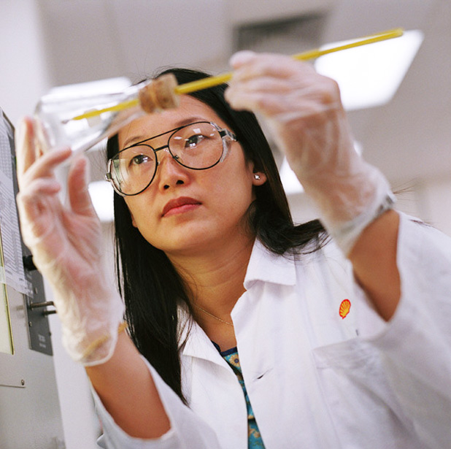
Safety First!
First and secondary Emergency Exits
Emergency contact numbers
Assembly Point
Fire drills scheduled
Alarm sirens/bell
First aid kits and first aid number (do we have a first aider in the room?)
Location of toilets
Location of coffee and tea, during break
Notes:
Discuss items directly related to your presentation area offshore.

Slide 4
CONTENTS
WHY HAVE THIS SESSION?
SESSION OVERVIEW
VIDEO & DISCUSSION
REALITY + SUMMARY
CONSEQUENCES
INTERVENTION
REPORTING
CLOSE
Notes:
Tell your team what you plan to do and how the session is structured
Why do we want to re-energise the 12 Life Saving Rules?
The Rules set out clear and simple ‘dos and don’ts’ covering activities with the highest potential safety risk.
New people join each year, so it is important to re-energise our Life-Saving Rules to ensure we all understand them and also how they apply in our workplace. The next slide will outline what are the desired outcomes from today’s engagement session.

Slide 5
Life-Saving Rules re-energise – Communication goals
After this session you should:
KNOW
The Life-Saving Rules
The Rules save lives
Why we need to know and follow them
How to intervene and report when you observe a violation
FEEL
Committed to the Life-Saving Rules – they could save your life
Intervention is an act of caring, not an accusation
Intervention could “save the life” of your colleague
DO
Ask if you need clarification
Agree to comply, observe, intervene and report
Discuss how to prevent Life-Saving Rule violations in team talks
Try out the reporting system if needed
Notes:
Explain why we are holding this session & what you want everyone to take away from it
Know:
What the Life-Saving rules are – which ones are most relevant for us, what this looks like in our day-to-day work and how to recognise violations
Understand that the Life-Saving Rules have saved many lives, decreased the number of (fatal) incidents, but still lives are lost which can be prevented by complying to the rules
That if you observe a violation you should intervene and report to avoid immediate and future incidents
Feel:
Emotionally (re)connected with the Life-Saving rules
That the Life-Saving rules are there to save lives and actually do save lives, which could be yours
That intervention is an act of caring, not an accusation and can save the life of people around you
Do:
Ask your supervisor / ask me for clarity on any of the rules
Agree on the next steps to comply, observe, intervene and report
Regularly discuss how to prevent Life-Saving Rule Violations in team talks

Slide 6
Since the Life-Saving Rules were introduced in 2009 one major O&G company reported that…
FATAL INCIDENTS
HAVE REDUCED BY
75%
LOST TIME INJURIES
HAVE REDUCED BY
42%
THIS MEANS OVER
30 LIVES
MAY HAVE BEEN
SAVED SINCE THE
LIFE-SAVING RULES
WERE IMPLEMENTED
The Life-Saving Rules Are Saving Lives
Notes:
Look at the content closely and personalise what you want to say
This one hour interactive session is to remind us all of the Life-Saving Rules and reflect on how we can keep ourselves and each other safe in the workplace.
Deliver the numbers of lives that have been saved simply and clearly
Consider to make it personal having a 2-3 minute discussion with your team (similar to a Safety Moment):
Who has an example of when they have witnessed and/or intervened in a Life Saving Rule relevant situation?

Slide 7
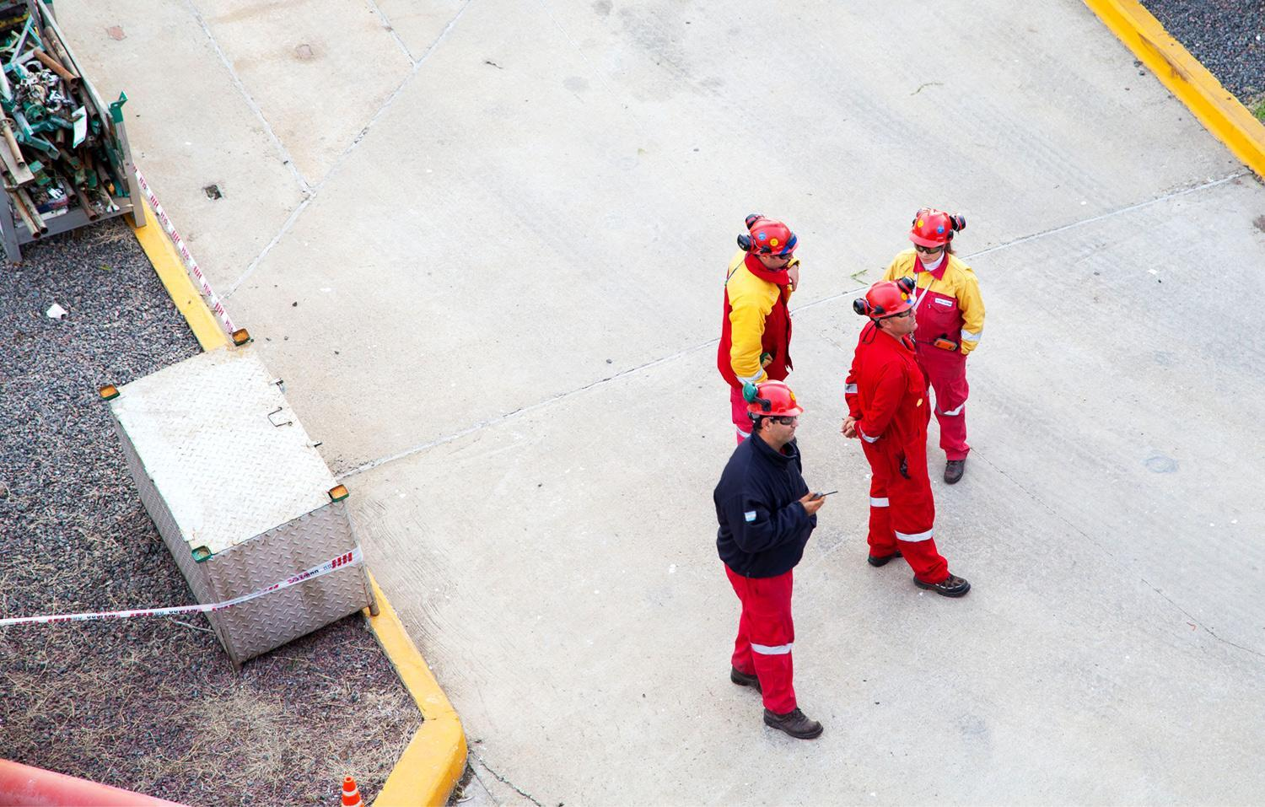
CONTENTS
WHY HAVE THIS SESSION?
SESSION OVERVIEW
VIDEO & DISCUSSION
REALITY + SUMMARY
CONSEQUENCES
INTERVENTION
REPORTING
CLOSE

Slide 8
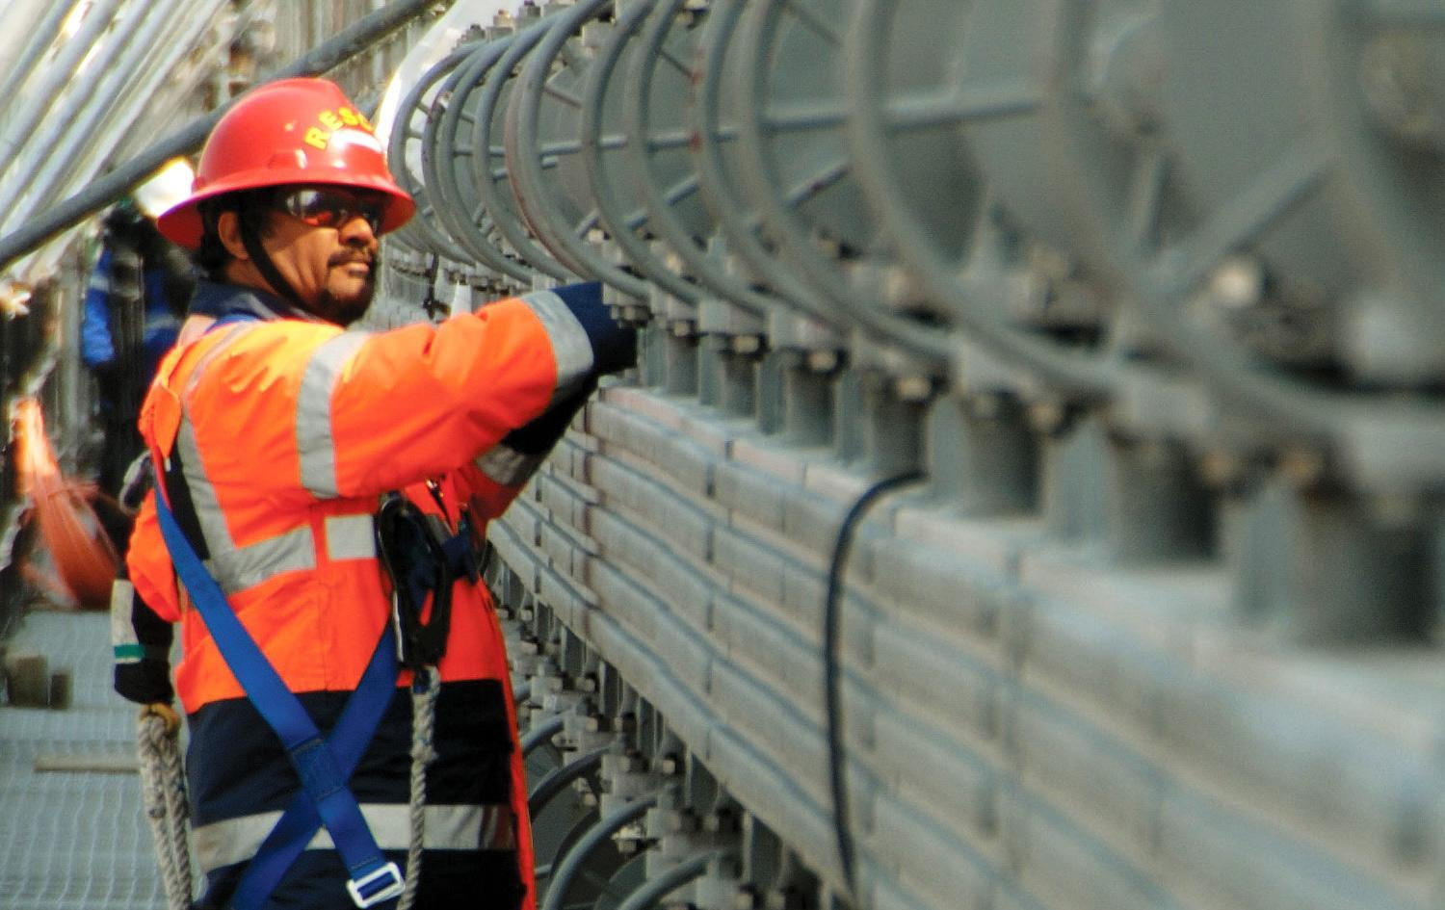
Plan for today’s session
Intro (10 minutes)
Video (2 – 5 minutes)
Discussion (10 minutes)
Reflection Video (2 minutes)
Discussion (15 minutes)
Reality + Summary (5 minutes)
Consequences (5 minutes)
How to Intervene (inc. peer to peer) (10 minutes)
Close (5 mins)
Notes:
Intent: Setting clear expectations
It is important to make the session as interactive as possible by asking questions and involving as many people as you can. Please take time in setting up your session in advance and giving yourself time for proper preparation.
Go through the running order – verify timings yourself. These might vary depending on whether you want to include some local examples or not

Slide 9
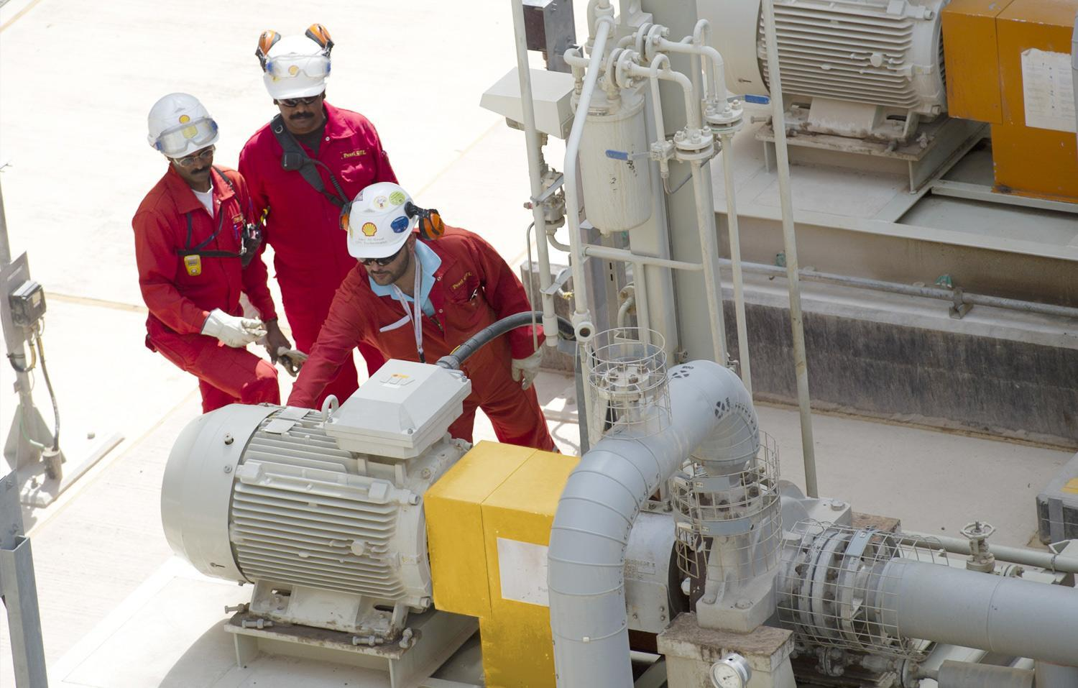
CONTENTS
WHY HAVE THIS SESSION?
SESSION OVERVIEW
VIDEO & DISCUSSION
REALITY + SUMMARY
CONSEQUENCES
INTERVENTION
REPORTING
CLOSE

Slide 10
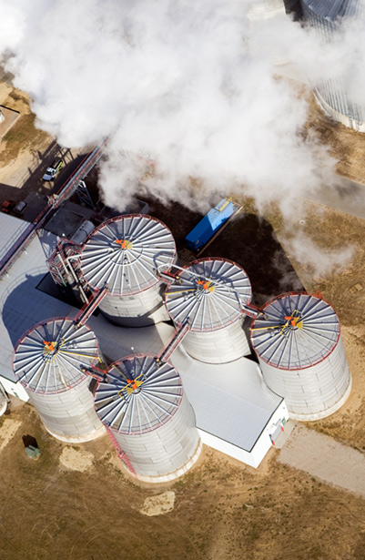
Video
We will now watch a short video of a typical work scenario
What we show here is a scenario from any Oil & Gas business
Your task: Spot safe acts! Spot unsafe acts!
Notes:
Intent: Interactive; Train observation skills, understanding and application of Rules at workplace, make them relevant to individuals work
Key Message: Everyone plays a role in watching out for each other - even before work is done
Process:
Invite audience to watch the short 2 min video
Advise them that the video is animated and shows at typical work scenario in any oil and gas business.

Slide 11
Video
First round watching the video: just observe
Go to next slide to view video
Notes:
The video contains several situations of compliance and non-compliance to the Life-Saving Rules
It is recommended to play the video a couple of times
It is likely that not all of them will be spotted.
Let the audience watch the video once to just observe safe and unsafe acts
Tell them you will play a reflection version of the video which highlights all the situations and you will discuss them one by one

Slide 12
Click ON Screen To Play Video

Slide 13
Discussion
Which Life-Saving Rules were followed and when?
Which Life-Saving Rules were broken and when?
Go to next slide to view video
Notes:
Play the video a second time and ask them to take notes about their observation
(Consider to play it a third time if needed by the audience)
After the video was played (x-times), start a discussion with the group.
What have they observed? Which compliant and non-compliant situations were discovered
Ask them to focus only on the Life Saving Rules, although they might identify other unsafe situations. If so, recognise them for their additional observation but make clear what is a Life Saving Rules and what is not
It is recommended to take notes of answers to reflect later if all situations have been identified.
Tell them you will play a reflection version of the video which highlights all the situations and you will discuss them one by one

Slide 14
Click ON Screen To Play Video

Slide 15
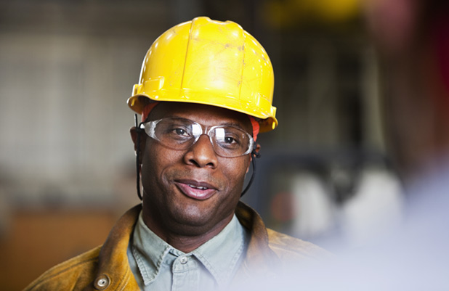
Discussion
Play Reflection Video
Green traffic light: Why is this compliant to the Life-Saving Rules?
Amber / Red traffic light: What has to change to make this compliant to the Life-Saving Rules?
Insert Reflection Video Here
Notes:
Play the reflection video (this time with the “solution” where all relevant acts are highlighted with a traffic light (red / green / amber) + the Life-Saving Rule symbol.
Green:
why is this situation compliant with the Life-Saving Rules, what is in place to keep the person safe?
Red:
why is this situation non-compliant with the Life-Saving Rules, what has to change, what is wrong here?
if this goes wrong, what could happen to the worker? (….he could lose his/her life)
Amber (optional: not all videos have amber situations covered):
why this situation is highlighted amber and not red or green?
what does the person need to do now to make it compliant to the Life-Saving Rules and to ensure he/she is safe?
Recognise the audience for active contribution and good discussion. Reinforce the message that our commitment to the Rules will keep us safe!

Slide 16
Click ON Screen To Play Video

Slide 17
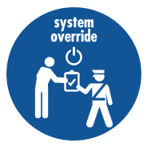
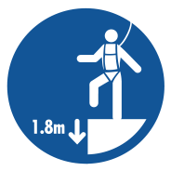
Discussion
What are the most important rules for us to follow in our work place?
How can we help each other follow the rules?
How do we set clear expectations on the Life-Saving Rules?
How do we help new people know and understand the Life-Saving Rules?
Notes:
Have another discussion and take notes of the answers you receive on a flipchart (or alternative):
Choose which questions are most relevant for your team, or if running a longer session all questions can be covered in order.
Which rules are especially relevant in your specific workplace?
What could be the consequences if that Rule was broken?
How does following the Rules keep us safe?
How can we help each other follow the rules?
How do we set clear expectations on the Life-Saving Rules?
How do we help new people?
OPTIONAL: For a deeper discussion ask participants to actually imagine and articulate how someone could get hurt or how someone is kept safe.

Slide 18
THE LIFE-SAVING RULES
Work with a valid work permit when required
Conduct gas tests when required
Verify isolation before work begins and use the specified life protecting equipment
Obtain authorisation before entering a confined space
Obtain authorisation before overriding or disabling safety critical equipment
Protect yourself against a fall when working at height
Do not walk under a suspended load
Do not smoke outside designated smoking areas
No alcohol or drugs while working or driving
While driving, do not use your phone and do not exceed speed limits
Wear your seat belt
Follow prescribed Journey Management Plan

Slide 19
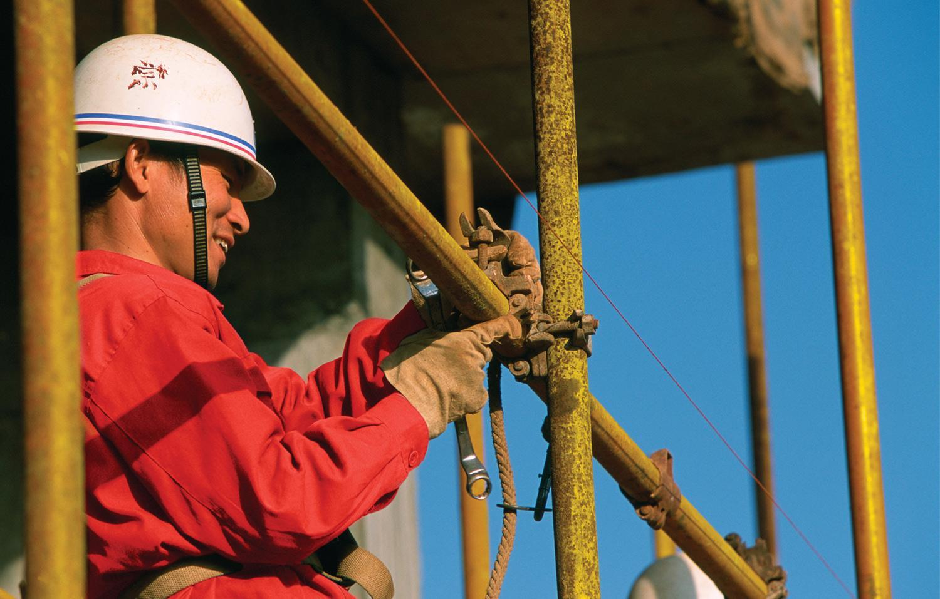
CONTENTS
WHY HAVE THIS SESSION?
SESSION OVERVIEW
VIDEO & DISCUSSION
REALITY + SUMMARY
CONSEQUENCES
INTERVENTION
REPORTING
CLOSE

Slide 20
Reality + Summary
The Life-Saving Rules have saved lives
We need to look after each other and follow the Life-Saving Rules without exception
They are there to save our life and the lives of others
Let´s be committed, not just compliant
If you work for us, you must follow the Life-Saving Rules
Notes:
You can use this slide to summarize again on the importance of the Rules
Make clear that the Rules are here to save peoples life
Our own lives and these of others around us
We need to help each other understanding and following the rules without exception
Let´s work together to establish a culture of commitment
You can use the slides provided, but also include examples of local incidents, or Rule breaches, or lives saved by complying with the Rules.
If you have any local examples / pictures, feel free to add these

Slide 21
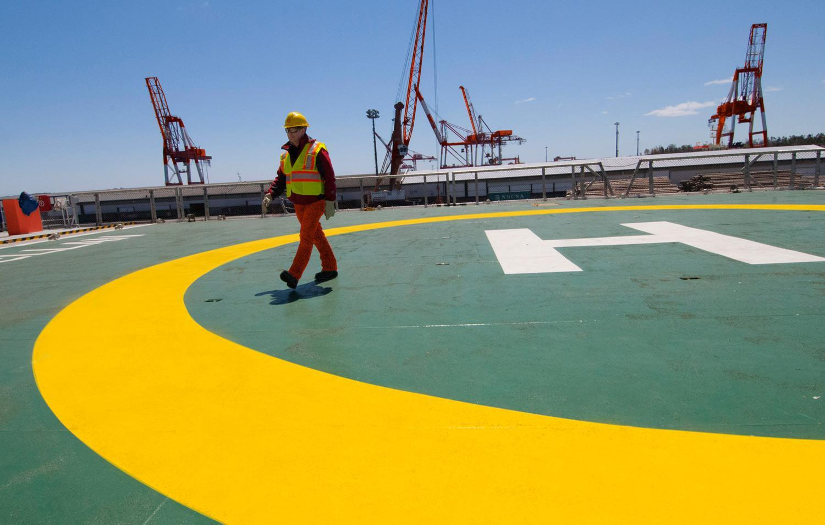
CONTENTS
WHY HAVE THIS SESSION?
SESSION OVERVIEW
VIDEO & DISCUSSION
REALITY + SUMMARY
CONSEQUENCES
INTERVENTION
REPORTING
CLOSE

Slide 22
Consequences
What happens if we follow the rules…
What happens if we don’t follow the rules…
Notes:
Intent: Make it personal; What would it mean to individuals;
We want positive consequences for following the Life-Saving Rules;
However the focus must be on Saving Lives.
Question: What could be the consequences be if we follow the Life-Saving rules?
Agree to all positive answers
Question: What could the consequences be if we do not follow the Life-Saving rules?
The worst consequences are that someone loses his or her life!
Consider a real story on what the impact was on the environment of someone who died at work (family, friends, supervisor, colleagues).

Slide 23
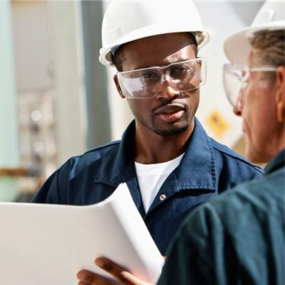
Consequences
What remains unchanged:
The aim of the Life-Saving Rules is to prevent harm and save lives
Each incident will be fully investigated
Failure to comply will result in maximum appropriate disciplinary action for all involved in accordance to local law
The Life-Saving Rules are there to save our life and the lives of others
If you choose to break the Rules, you choose not to work for us.
Notes:
Check how your Company applies disciplinary action before facilitating this session
There is no change to the consequence management. Consistent “consequence management” is part of what has enabled Saving Lives so far and it remains necessary to reinforce the importance of compliance with the Life-Saving Rules.
If the employee is aware of the rule or required procedure through training, experience or communication, and did not comply with that rule or procedure, the maximum appropriate disciplinary action (in accordance with local law) will be applied. In addition, if a supervisor tolerates the conditions for rule breaking e.g. if an employee is not fully aware, or equipped to comply, or fails to follow through if a Rule is broken, maximum appropriate disciplinary action (in accordance with local law) will apply to the supervisor, or his / her supervisor as well. This is because it is their role to make sure their staff do know and are equipped to comply with the Life-Saving Rules.

Slide 24
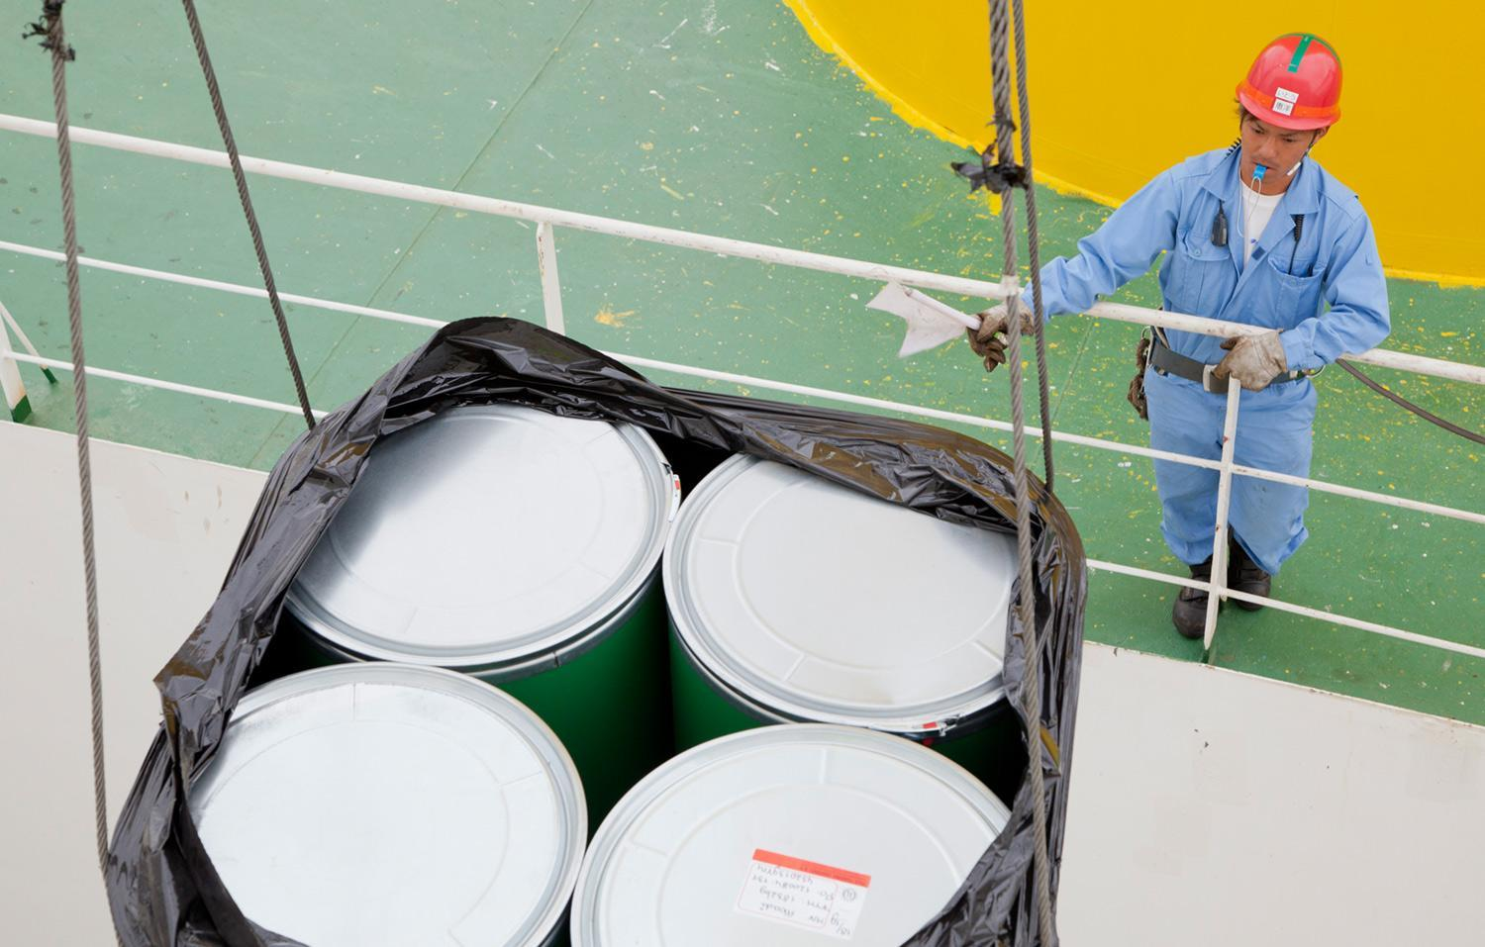
CONTENTS
WHY HAVE THIS SESSION?
SESSION OVERVIEW
VIDEO & DISCUSSION
REALITY + SUMMARY
CONSEQUENCES
INTERVENTION
REPORTING
CLOSE

Slide 25
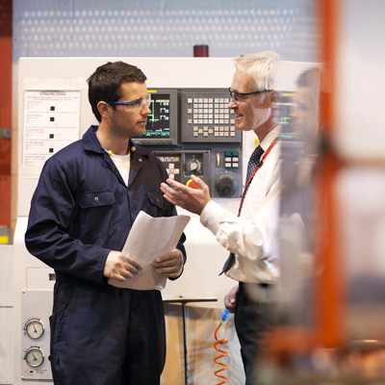
Intervention
What is an intervention?
A conversation between at least two people
Should relate to a safe or an unsafe act
Learning opportunity
Includes open questions and active listening
Focuses on what could go wrong
Agrees an immediate action
Focus on the behaviours, not the individual
Why do we want everyone to intervene?
Care for each other, save lives and prevent injuries creating a safer working environment
You and I are responsible to intervene with each other. Failure to intervene is like an unsafe act.
Whenever somebody intervenes with you, there is only one correct answer – THANK YOU!
Notes:
Intent: Understand the importance of intervention;
It is key to look after each other and to be committed to follow the Rules
Our focus is on being safe as team;
There is no difference between employees and contractors;
Encourage contractors to intervene with employees;
Everyone should watch out for each other; Make it personal;
Re-enforce the message:
Why do we want everyone to intervene?:
To help creating a proactive and safe working environment, because
We want to save lives,
We want to prevent injuries and
We have to look after each other
Key message:
If something goes wrong, we don‘t want to ask ourselves ‘could I have done more?‘

Slide 26
Peer to Peer Intervention
What is different about peer to peer interventions?
Colleagues in the same team (peers) can and do look out for each other.
Intervention with a peer can happen before a rule is broken OR to correct an unsafe act or situation.
Intervention and reporting within your team is a learning opportunity and will not normally be subject to disciplinary action if the unsafe activity stops immediately.
When you intervene with a peer you are helping to keep them safe and stay out of trouble.
Please report all interventions as it helps the company learn and become an even safer place to work.
Notes:
Consider to adjust the following point in the main slide if not appropriate for your organisation:
Intervention and reporting within your team is a learning opportunity and should be encouraged therefore should not be subject to disciplinary action if the unsafe activity stops immediately.
Intent: Understand that peer to peer interventions are out of care for colleauges, peer to peer interventions are about a team looking after itself;
Everyone should watch out for each other; Make it personal;

Slide 27
CONTENTS
WHY HAVE THIS SESSION?
SESSION OVERVIEW
VIDEO & DISCUSSION
REALITY + SUMMARY
CONSEQUENCES
INTERVENTION
REPORTING
CLOSE

Slide 28
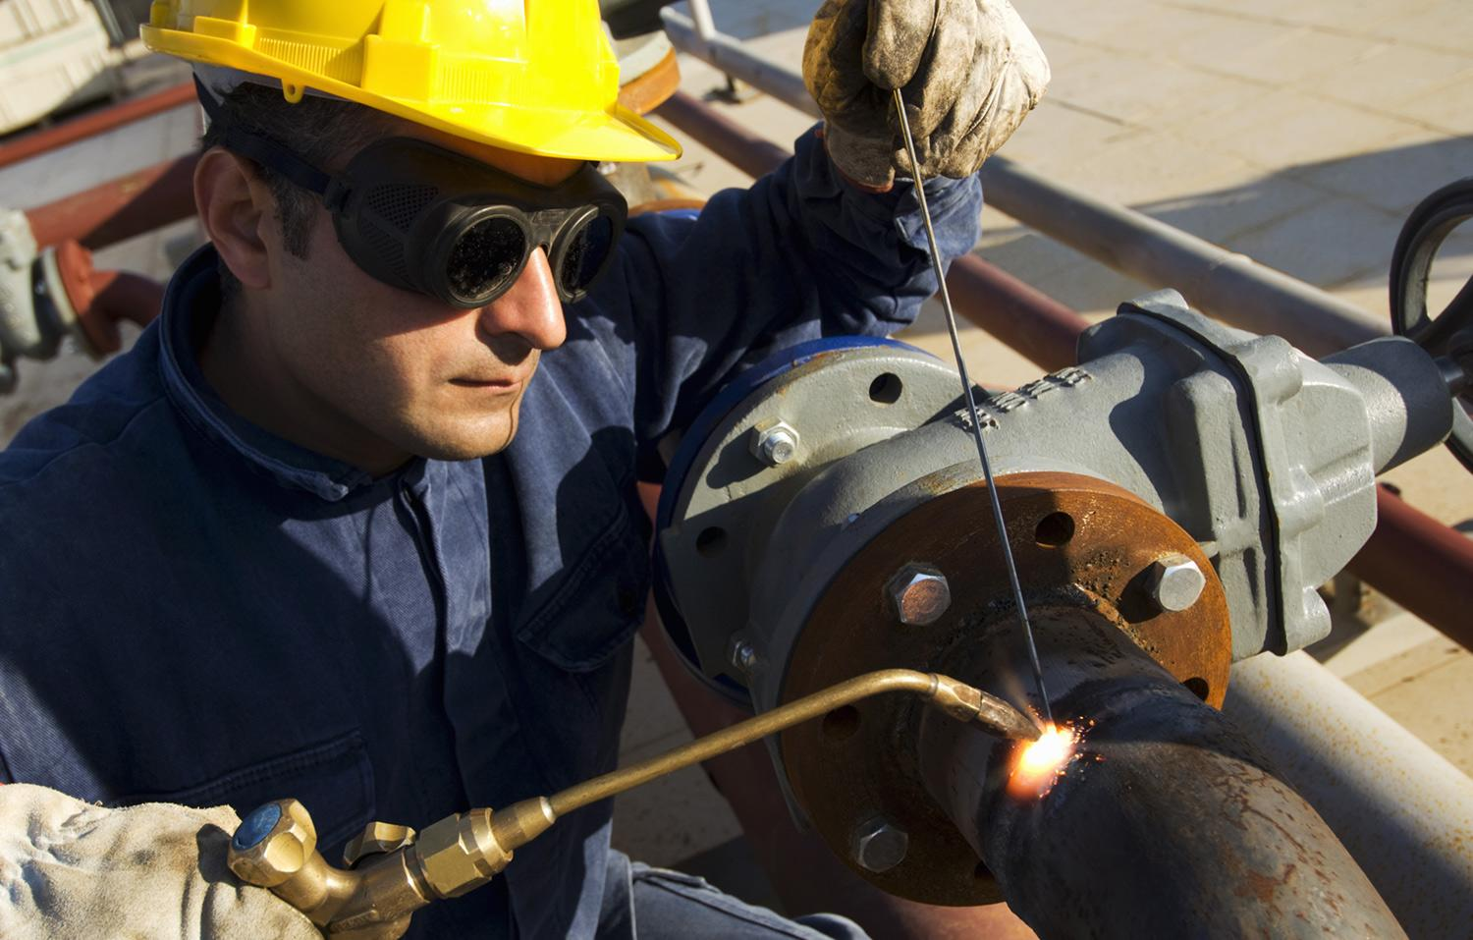
Reporting
When you see someone break a Life-Saving Rule:
1.
STOP IT
2.
REPORT IT
Reporting is not about blame. It’s about collecting information to help us understand why rules are being broken and what we need to do to make sure it doesn’t happen again.
Notes:
Intent: Understand the importance of intervention; Understand how to deal with interventions; Know what your company expects you to do when you see someone break a Life-Saving Rule
Key Messages:
You should always intervene and whenever somebody intervenes with you, there is only one correct reply - THANK YOU!
You have a duty to report any Life-Saving Rule Violations to help understand why there was a violation and any necessary actions can be taken to make compliance easier
Peer to peer reporting is all about reporting to learn about issues with a specific Rule, not about the person breaking it!
Check how your Company applies disciplinary action before facilitating this session
4. Intervention and reporting within your work team (peer to peer) should be encouraged therefore should not be subject to disciplinary action if the unsafe activity stops immediately.
5. For a violation observed by a supervisor maximum appropriate disciplinary action should always apply

Slide 29
CONTENTS
WHY HAVE THIS SESSION?
SESSION OVERVIEW
VIDEO & DISCUSSION
REALITY + SUMMARY
CONSEQUENCES
INTERVENTION
REPORTING
CLOSE

Slide 30
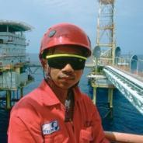
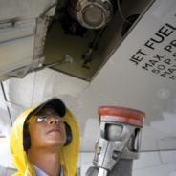
Close
THANK YOU for your active participation and please remember:
Follow the Life-Saving Rules and help others to comply!
By intervening you might save someone’s life. By not complying you might lose your life!
Notes:
Thank the audience for their time, effort and commitment
Ensure that actions / notes taken during the session will be followed up.

